Slide 1

Alphashots.AI Currency Analysis
This presentation explores the EUR/INR exchange rate dynamics using technical analysis tools. We'll delve into moving averages, Bollinger Bands, and the Commodity Channel Index (CCI) to uncover potential trading opportunities.
By Venkatasai Padala

Slide 2

Introduction
1
Analysis Objective
2
Technical Analysis Tools
We aim to identify key trends and patterns in the EUR/INR exchange rate data.
The study utilizes moving averages, Bollinger Bands, and the CCI to gain insights into price movements.

Slide 3
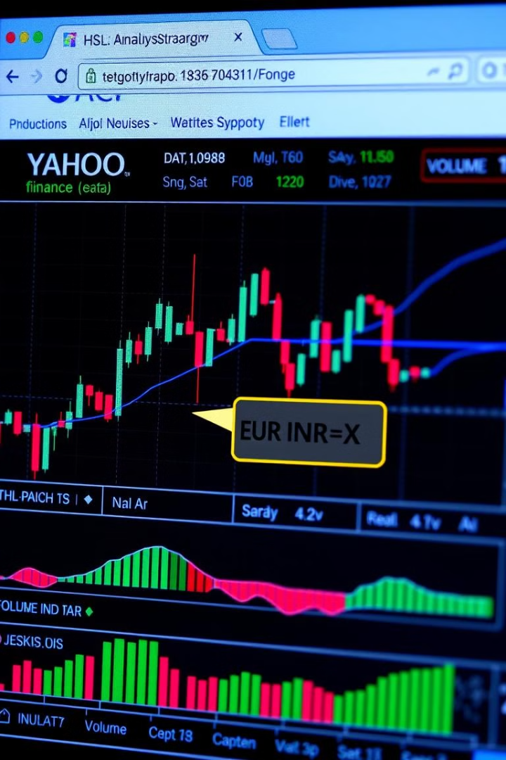
Data Source
Provider
Ticker Symbol
Yahoo Finance provides the historical data for the EUR/INR exchange rate.
The ticker symbol EURINR=X represents the EUR/INR exchange rate.
Date Range
The analysis focuses on data from January 1, 2023, to September 30, 2024.

Slide 4

Data Preparation
1
Import Libraries
Necessary libraries, such as Pandas, NumPy, and Matplotlib, are imported for data manipulation and visualization.
2
Load Data
The historical EUR/INR data is loaded into a Pandas DataFrame for analysis.
3
Data Cleaning
The data is cleaned and preprocessed to ensure accuracy and consistency.
4
Identify Key Columns for Analysis and Calculating moving averages, Bollinger Bands, and CCI-Commodity Channel Index
5
VisualiZation and Dataset of Excel For Descision Making (Sell,Buy,Normal)

Slide 5




Moving Averages
20-Day Moving Average
50-Day Moving Average
Crossovers
Represents the average closing price over the past 20 trading days.
Represents the average closing price over the past 50 trading days.
Crossovers between these moving averages can provide insights into potential trend changes.

Slide 6
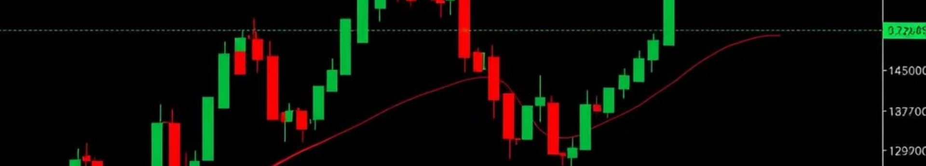
Bollinger Bands
Indicator
Description
Moving Average
Represents the average closing price over a specified period (e.g., 20 days).
Standard Deviation
Measures the volatility of the price around the moving average.
Bands
The upper and lower bands are calculated by adding and subtracting a multiple of the standard deviation from the moving average.

Slide 7
Commodity Channel Index (CCI)
Purpose
Overbought/Oversold Signals
Trend Confirmation
The CCI measures the current price's deviation from its average price.
When the CCI is above +100, it suggests an overbought condition, while values below -100 indicate an oversold condition.
CCI can be used to confirm trends identified by other technical indicators.

Slide 8
Code Explanation :
Step 1 - Setup Install Libraries
Libraries like pandas, yfinance, and matplotlib provide tools to fetch, manipulate, and visualize financial data.
Command: pip install pandas yfinance matplotlib
Purpose: This step ensures all necessary packages are installed to handle data retrieval and processing.
Step 2 - Data Import Fetch Historical Data
Using the yfinance API, we download EUR/INR exchange rate data for a specified date range.
Define ticker, start_date, and end_date to set up the data range.
Purpose: This retrieves the historical data, forming the foundation of our analysis.
Step 3 - Data Structuring Flatten and Identify Columns
After downloading, the DataFrame’s structure is flattened for ease of access to each column.
Columns like Close, High, and Low prices are identified for further analysis.
Purpose: Helps streamline data manipulation and ensures consistency in selecting the right price columns for calculations.

Slide 9
Step 4 - Calculate Moving Averages 20-Day & 50-Day Moving Averages
Moving Averages (MA) are calculated using rolling averages on the Close price, providing insights into price trends.
20-Day MA: Short-term trend indicator
50-Day MA: Long-term trend indicator
Purpose: Moving averages help smooth out price data and highlight trends over time.
Step 5 - Bollinger Bands Calculation Calculate Bollinger Bands
Bollinger Bands are constructed by adding and subtracting 2 times the rolling standard deviation from the 20-Day MA.
Upper Band = MA + 2 × Rolling Std Dev
Lower Band = MA - 2 × Rolling Std Dev
Purpose: Bollinger Bands help identify volatility and potential reversal points by showing overbought and oversold conditions.
Step 6 - Commodity Channel Index (CCI) Calculation Calculate CCI
CCI is calculated based on the Typical Price, 20-Day Moving Average, and Mean Absolute Deviation (MAD).
Formula: CCI = (Typical Price - MA) / (0.015 × MAD)
Purpose: CCI helps identify overbought or oversold conditions and the potential for price reversals.

Slide 10
Step 7 - Data Validation Check for Missing Data (NaNs)
Data validation includes checking for NaN values in Moving Averages, Bollinger Bands, and CCI columns.
These gaps, if any, are due to insufficient data in the initial period and are typically ignored in long-term analysis.
Purpose: Ensures that our calculations are accurate and that missing data doesn’t skew results.
Step 8 - Final Output
Display and Interpret Results
The final DataFrame displays calculated MAs, Bollinger Bands, and CCI values.
Visualizing this data (in a graph) offers a comprehensive view of trends, market volatility, and potential buy/sell signals.

Slide 11
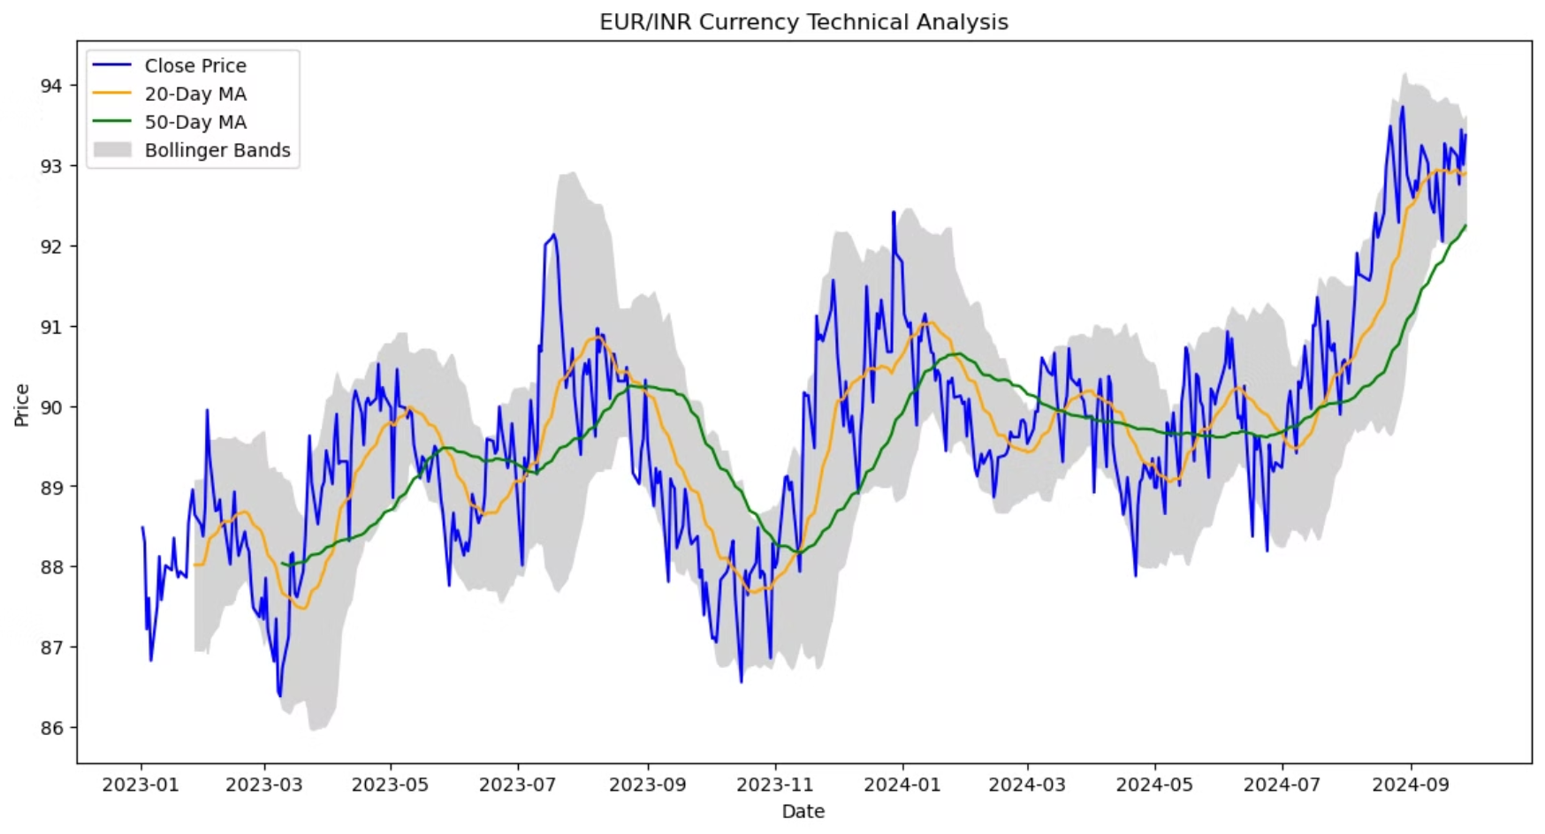
Visualization:

Slide 12
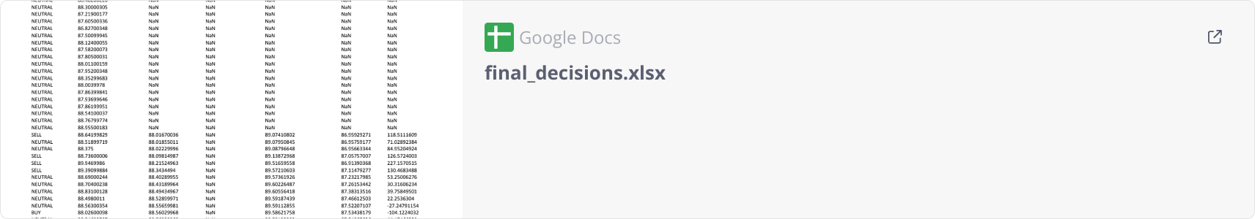
A table displaying BUY,SELL,? or NEUTRAL? decision for each individual indicator-

Slide 13

Future Plan
Expand Indicator Set: Add indicators like RSI and MACD for deeper analysis.
Machine Learning Integration: Use ML models to enhance prediction accuracy.
Automate Analysis: Build a pipeline for real-time data and signal processing.
Risk Management: Apply stop-loss and take-profit to protect investments.
Monthly Reporting: Generate monthly insights to refine trading strategies.

Slide 14
Challenges Faced in EUR/INR Technical Analysis
Data Quality and Availability
Limited and sometimes inconsistent data led to potential analysis gaps. Managed this by using reliable date ranges and filling gaps for accuracy.
Technical Complexity of Indicators
Calculating Moving Averages, Bollinger Bands, and CCI required precise implementation to avoid errors. Verified calculations step-by-step for reliable results.
Handling Missing Values
Initial values for indicators often led to NaNs, affecting early data points. Addressed this by filtering calculations to ensure valid outputs.
Trading Signal Interpretation
Translating indicators into clear buy/sell signals was challenging due to varying market conditions. Developed a combined approach using crossover and volatility insights.
Effective Visualization and Presentation
Summarizing technical insights for clear decision-making was complex. Used well-chosen charts to illustrate indicator impacts on trading strategies.

Slide 15




Conclusion
Key Trends
Potential Trading Strategies
Risk Management
The analysis reveals key trends in the EUR/INR exchange rate.
The insights derived from the technical analysis can inform potential trading strategies.
Understanding market risks is crucial when implementing any trading strategies.

